Slide 1
HEALTHCARE PROVIDER FRAUD DETECTION
By: Omar Sherif, Omar Ayman, Ahmed Hassan, Ahmed Amr, Abdullah Mahmoud

Slide 2
Problem & Business Impact:
Provider fraud is a major challenge for Medicare, driving significant unnecessary spending and increasing healthcare costs. Fraud often involves inaccurate billing, exaggerated procedures, or claims for services never delivered.
Business Impact:
  Saves Money: Helps stop fake or incorrect Medicare payments.
  Improves Investigations: Tells auditors which providers to check first.
  Builds Trust: Makes the Medicare system more fair and reliable.
Our objective is to build a machine learning system to identify potentially fraudulent providers based on their claim patterns and to uncover the key factors that signal high-risk behavior.

Slide 3
Data Exploration & Feature Engineering
Understanding the dataset
Performing data quality checks
Exploring beneficiaries, claims, and labels
Engineering provider-level features
Preparing the dataset for modeling

Slide 4
🔹 Performing data quality checks
We assess the completeness and consistency of the data.
This includes checking for missing values in chronic conditions or cost fields, identifying duplicates or inconsistent claim records, and flagging extreme outliers in billing amounts.
These checks ensure the dataset is reliable and that errors do not mislead the model.

Slide 5
🔹 Understanding the dataset
This step involves examining all four Medicare files—beneficiary, inpatient, outpatient, and provider labels—to understand what each table represents, how they connect through keys like BeneID and Provider, and what the level of granularity is.
It helps us identify which information belongs to patients, which belongs to claims, and what finally maps to each provider, which is our prediction target.

Slide 6
🔹 Performing data quality checks
We assess the completeness and consistency of the data.
This includes checking for missing values in chronic conditions or cost fields, identifying duplicates or inconsistent claim records, and flagging extreme outliers in billing amounts.
These checks ensure the dataset is reliable and that errors do not mislead the model.

Slide 7
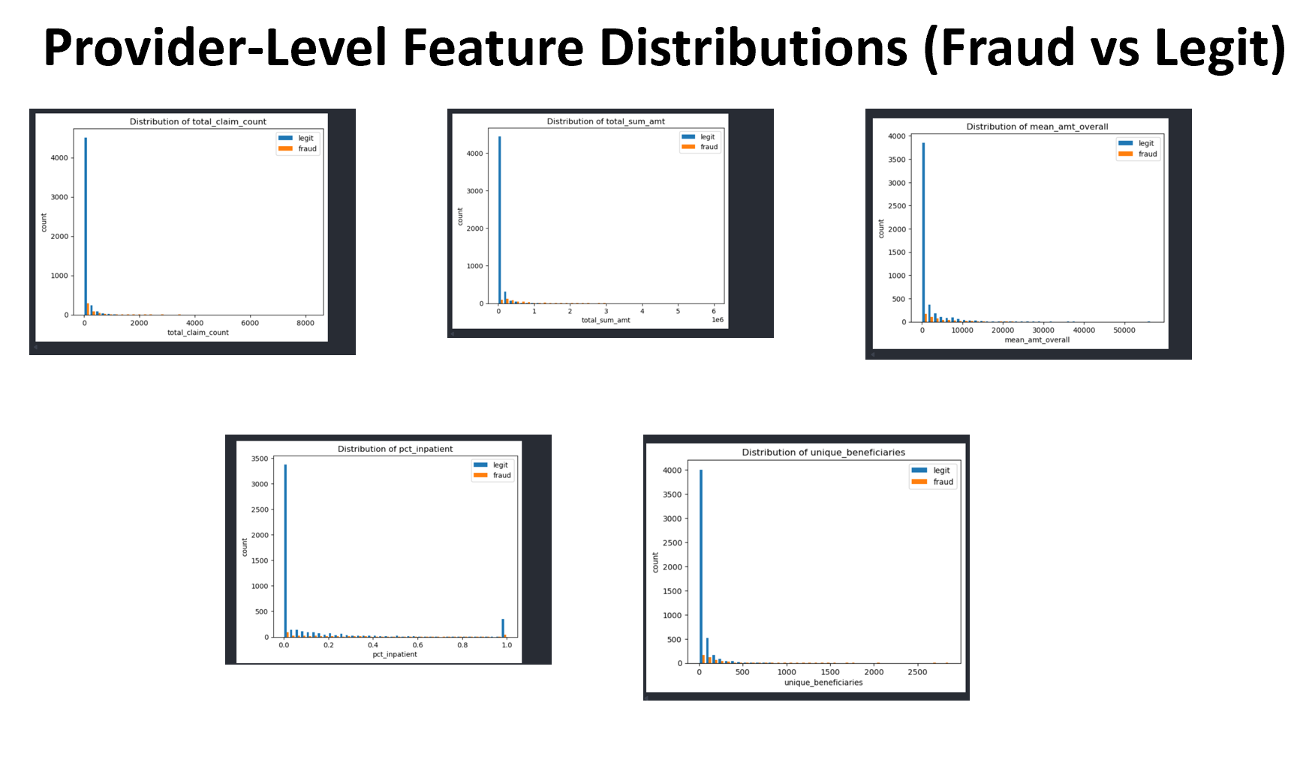
🔹Data Visualization

Slide 8
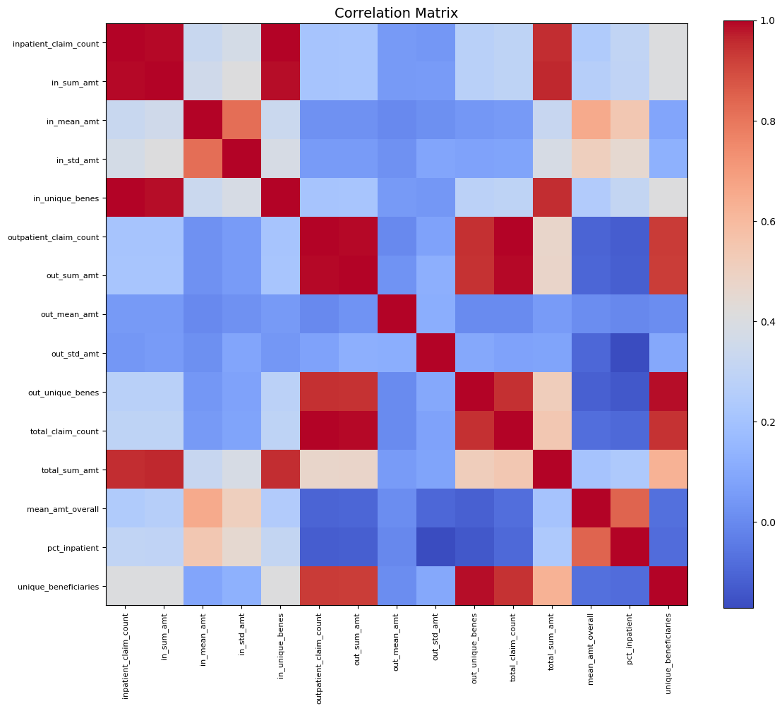
Correlation Matrix

Slide 9
🔹 Exploring beneficiaries, claims, and labels
In this stage, we analyze patterns in the patient population, claim behaviors, and fraud labels.
We compare fraudulent and non-fraudulent providers by looking at claim counts, total billed amounts, patient characteristics, and usage patterns.
This exploration helps us understand which behaviors may indicate fraud and guides the feature engineering process.

Slide 10
🔹 Engineering provider-level features
Because the prediction is made at the provider level, we aggregate all claim-level data into meaningful statistics for each provider.
This includes features such as total claims, average claim cost, number of unique patients, inpatient/outpatient ratios, procedure counts, and high-cost claim percentages.
These engineered features capture provider behavior and create a rich, structured dataset for the model.

Slide 11
🔹 Preparing the dataset for modeling
Finally, we clean and transform the full feature set to make it ready for training.
This includes handling missing data, encoding categorical fields, scaling numerical variables if needed, and splitting the data into training, validation, and test sets.
We also address class imbalance to ensure the model learns to detect the minority fraud class effectively.

Slide 12
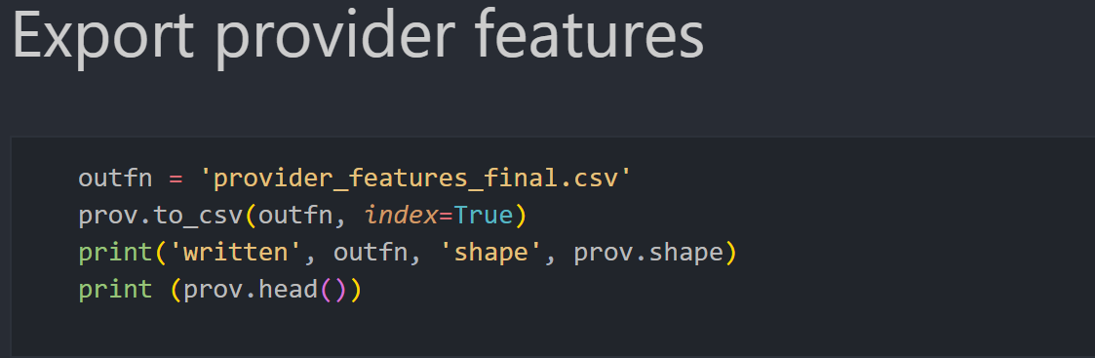
final step of our feature engineering stage
After finishing all the feature engineering steps — combining inpatient, outpatient, and beneficiary information — we ended up with one clean table where each row represents a single provider, along with all the aggregated features we generated.

Slide 13
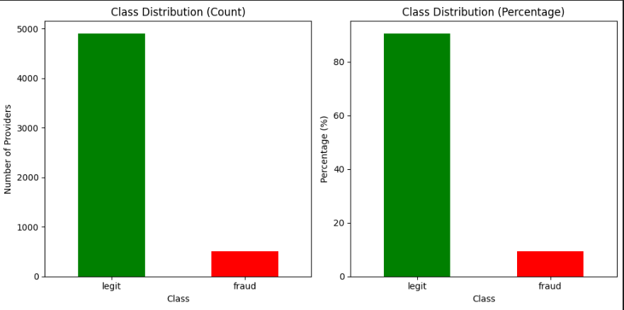
Class Imbalance Challenge
Major challenge: models will be biased toward predicting 'legitimate' and miss fraudulent cases, which is exactly what we need to detect."
Imbalance Ratio (legit:fraud): 9.69:1
Fraud represents 9.35%

Slide 14
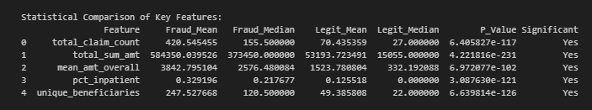
Class Imbalance Analysis
Fraud providers have much higher values than legitimate ones across all key features.
Differences are statistically significant (p < 0.05).
Shows that the dataset is highly imbalanced and contains outliers.
Highlights the need for a careful class imbalance handling strategy (e.g., SMOTE-ENN rather than simple oversampling).

Slide 15
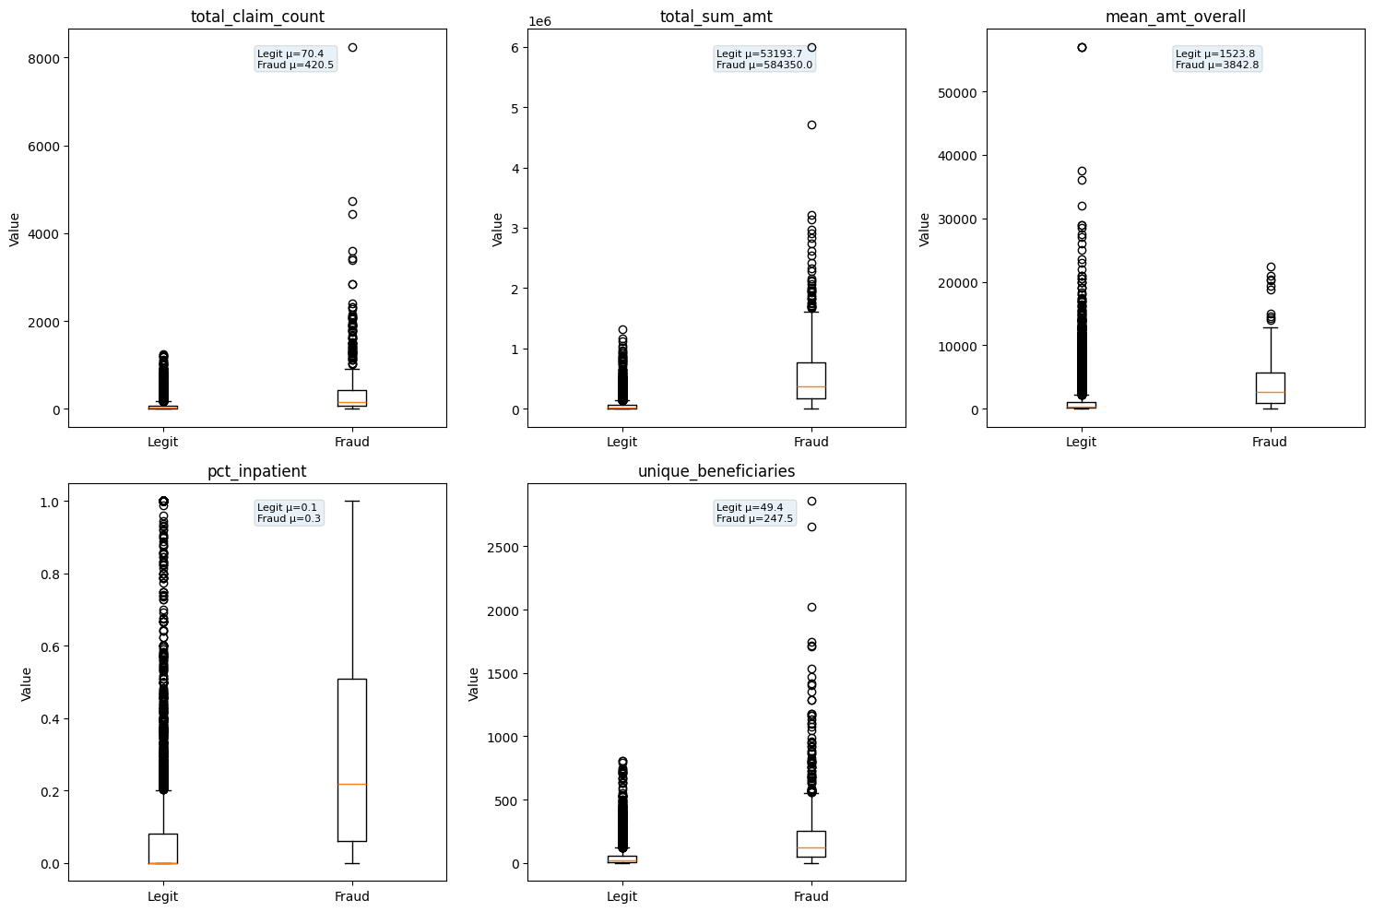
Outlier Analysis
-Some features (e.g., total_claim_count, total_sum_amt, unique_beneficiaries) have extremely high values in fraud providers.
-Outliers can distort oversampling methods like SMOTE.
-Visualization: Box plots show that fraud providers often exceed the upper whiskers of legitimate ones.
-Conclusion: Outlier-aware strategies (like SMOTE-ENN) are preferable for balancing classes.

Slide 16
Approaches to Handle Class Imbalance
1. Class Weighting
Increases penalty for misclassifying the minority class (fraud)
Simple to implement in most models
Limitation: Unstable with extreme imbalance (like in our data) → low performance in tests
2. Oversampling
Random Oversampling: duplicates minority samples → risk of overfitting
SMOTE (Synthetic Minority Oversampling Technique): generates synthetic samples
  Interpolates between minority neighbors
  Limitation: Outliers in fraud data can distort boundaries → may create unrealistic samples
  In our dataset, SMOTE without cleaning led to unstable results due to extreme fraud outliers

Slide 17
Approaches to Handle Class Imbalance
3. Undersampling
Removes majority class samples to balance dataset
Risk: loss of potentially important data → reduces model learning capacity
4. Hybrid Methods
Combines SMOTE + ENN: Oversample minority, clean noise from majority
Benefits for our dataset:
  Handles extreme outliers in fraud providers
  Produces cleaner, more reliable decision boundaries
  Shown in our analysis to improve precision, recall, and F1-score significantly

Slide 18
Why We Used SMOTEENN
1. Data Characteristics
Severe class imbalance: minority (fraud) << majority (legit)
Presence of extreme outliers in key features (e.g., total_sum_amt, total_claim_count, unique_beneficiaries)
2. Why Not Class Weighting
Unstable with severe imbalance
Poor performance in metrics like F1-score, Precision, Recall
3. Why Not Simple Oversampling
Random oversampling → duplicates → risk of overfitting
SMOTE → synthetic samples can distort boundaries if outliers exist

Slide 19
Why We Used SMOTEENN
4. Why Not Undersampling Alone
Removes majority samples → risk of losing important legit data
5. Advantages of SMOTEENN
SMOTE: generates synthetic minority samples
ENN (Edited Nearest Neighbors): cleans noisy or borderline majority samples
Balances the classes without creating unrealistic points
Improves model performance and generalization

Slide 20
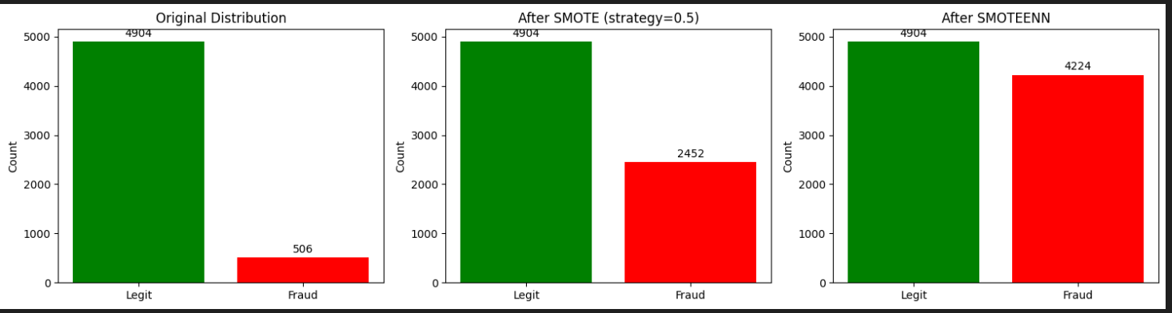
Data distribution after SMOTEENN

Slide 21

Files Exported for Modeling

Slide 22
Modeling:
Decision Tree
Random Forest
Gradient Boosting
Logistic Regression
Support Vector Machine (SVM)
We use 80% Train & 20% Test

Slide 23
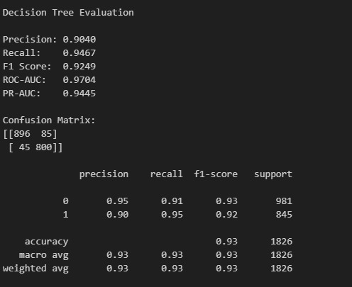
Decision Tree
A Decision Tree works by repeatedly splitting the data into smaller groups based on features that best separate the classes, forming a flow-chart–like structure that leads to a prediction. The parameters you tuned control how complex or simple the tree becomes. max_depth limits how deep the tree can grow—higher depth allows the model to learn more detailed patterns but can increase overfitting. min_samples_split sets the minimum number of samples required to make a split, so larger values reduce the number of splits and create a smoother, more general tree. min_samples_leaf forces each leaf to contain a minimum number of samples—bigger values prevent very specific, noisy leaves.
Default decision tree parameters :
DT_PARAMS = {
"max_depth": 10,
"min_samples_split": 20,
"min_samples_leaf": 10,
"random_state": 42,
}

Slide 24
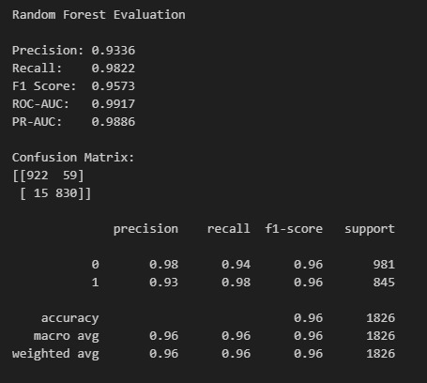
Random Forest
Random Forest is an ensemble model that builds many decision trees and combines their predictions to get a stronger, more stable result. Each tree sees slightly different data and features, so the model becomes more accurate and less likely to overfit compared to a single tree. The key parameters that control how many trees are built (n_estimators), how features are selected (max_features), and how the model handles class imbalance (class_weight). Changing these parameters can make the model more or less accurate, more generalizable, or sometimes slower to train. Overall, Random Forest works by reducing noise and improving prediction reliability through the power of averaging many trees.
Default params random forest : RF_PARAMS = {
"n_estimators": 300,
"random_state": 42,
"n_jobs": -1,

Slide 25
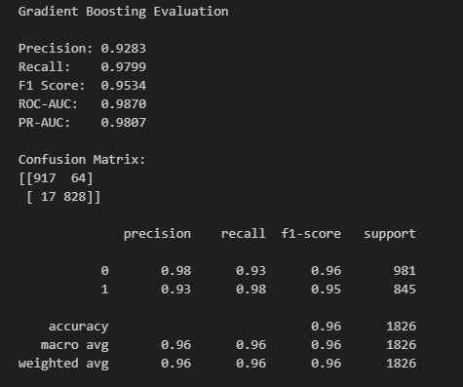
Gradient Boosting
Gradient Boosting works by training many small decision trees one after another, where each new tree focuses on fixing the errors made by the previous ones. Instead of learning everything at once, the model improves step-by-step, gradually reducing mistakes. The learning_rate controls how big each correction step is — smaller values (like 0.01) make learning more careful and usually improve generalization, while larger rates make the model learn faster but risk overfitting. The n_estimators parameter sets how many boosting rounds (trees) the model builds; more trees allow deeper refinement of mistakes but only help if the learning rate is small enough. Finally, subsample determines what fraction of the data each tree sees; using values below 1.0 introduces randomness that reduces overfitting and usually improves performance. Overall, Gradient Boosting is a strong learner because it combines many small improvements, allowing it to capture patterns deeply while remaining flexible through its parameters.
GB_PARAMS = {
"n_estimators": 300,
"learning_rate": 0.05,
"max_depth": 5,
"min_samples_split": 5,
"min_samples_leaf": 2,
"subsample": 0.8,
"max_features": "sqrt",
}

Slide 26
Logistic Regression & Support Vector Machine
Logistic Regression is a simple linear model that predicts the probability of fraud based on a weighted combination of features. It’s fast, easy to interpret, and serves as a strong baseline.
SVM tries to find the best boundary that separates fraud and non-fraud providers by looking at the closest data points “support vectors” and maximizing the margin between the two classes.

Slide 27
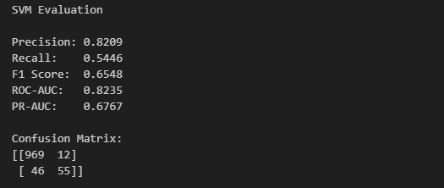
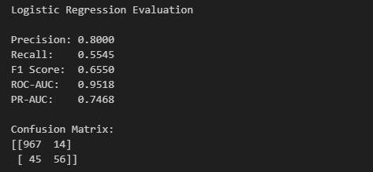
Using Provider_features dataset:
Test: 1082
Not Fraud: 981
Fraud: 101

Slide 28
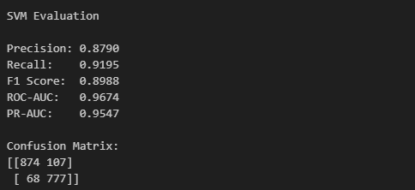
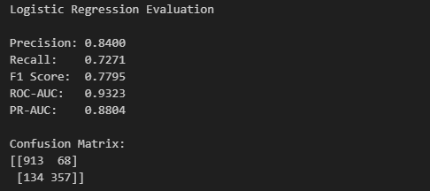
Using data_smote_resampled dataset:
Test: 1472
Not Fraud: 981
Fraud: 491

Slide 29
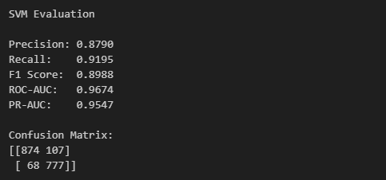
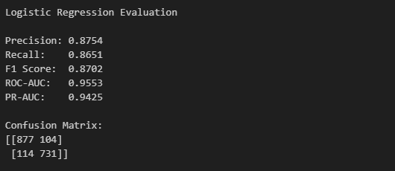
Using data_smoteenn_cleaned dataset:
Test: 1826
Not Fraud: 981
Fraud: 845

Slide 30
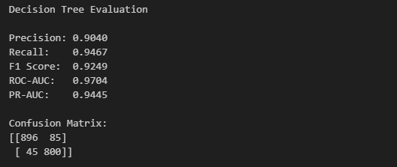
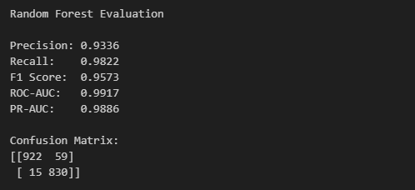
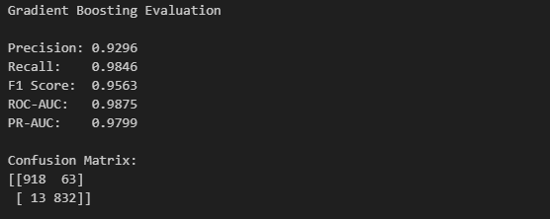
Which is better?

Slide 31


